Slide 1


PIG+ Sqoop
+

Slide 2
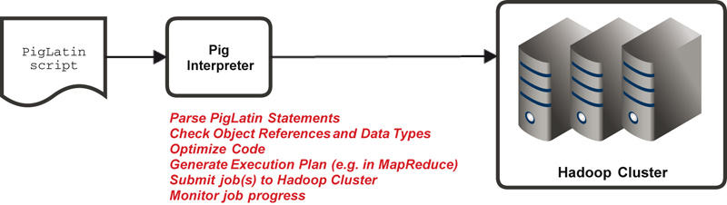
PIG Latin Execution

Slide 3
PIG Modes
Local
MapReduce (default)
Tez_local
Tez (on Hortonworks clusters)

Slide 4
Commonly Used Bag Functions
FILTER
Only the tuples that match a given criterion are retained in the target bag
FOREACH
Iterate through each tuple in the source bag
ORDER
Order tuples by a given field
DESCRIBE
Describe the schema of a particular bag
ILLUSTRATE
Describes the schema along with the lineage of the particular bag

Slide 5
Commonly Used Functions
Evaluation Functions
AVG, COUNT, MAX, MIN, SIZE, SUM, TOKENIZE
String Functions
STARTSWITH, ENDSWITH, LOWER, UPPER, LTRIM, RTRIM, TRIM, REGEX_EXTRACT
Datetime Functions
CurrentTime, DaysBetween, GetDay, GetHour, GetMinute, ToDate
Mathematical Functions
ABS, CEIL, EXP, FLOOR, LOG, RANDOM, ROUND
Notes:
PIG functions operate on a field and hence are typically available with a for each operation.

Slide 6
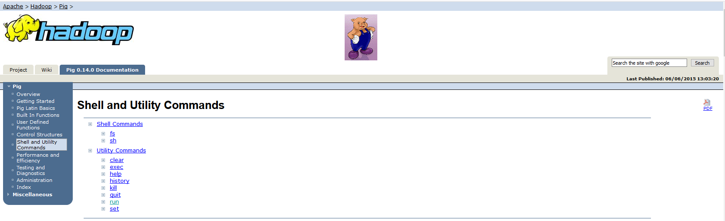
Shell Commands
https://pig.apache.org/docs/r0.15.0/cmds.html#run

Slide 7
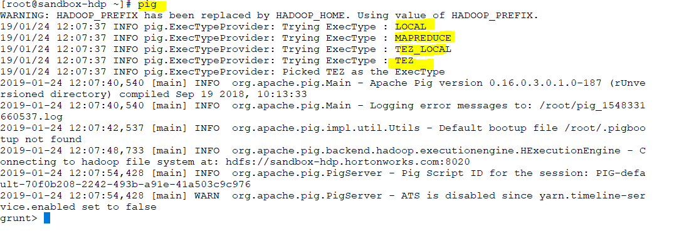
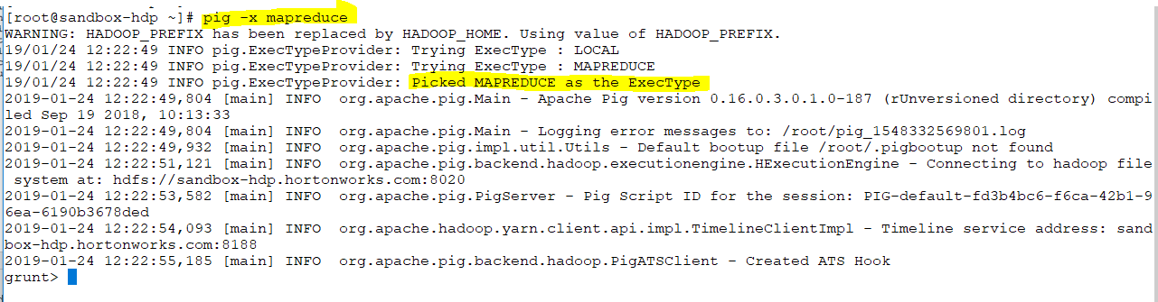
Notes:
By default its
Pig–x local :it starts in local mode. your program does not rely on Hadoop cluster .It relies on local file system .It will data file system .It treats your local file system as intermediate storage .Every program require intermediate storage .
after it reads it will write in local file system .
Pig –x mapreduce : this starts in distributed environment .It means pig will run in a cluster and it consider cluster file system as its file system so if cluster is using HDFS as its file system then it use it as files system .and also map reduce is going to use map reduce engine as its engine.
We mentioned Hadoop has two parts :HDFS AND ENGINE(processing engine) .so Map reduce is the default processing engine .There are many like Spark ,Tez ,…
Pig – x Tez_local : its going to your local environment but its using Tez as processing engine
Pig – x Tez : its going to run in distributed env. However it will use Tez AS PROCESSING ENGINE.

Slide 8
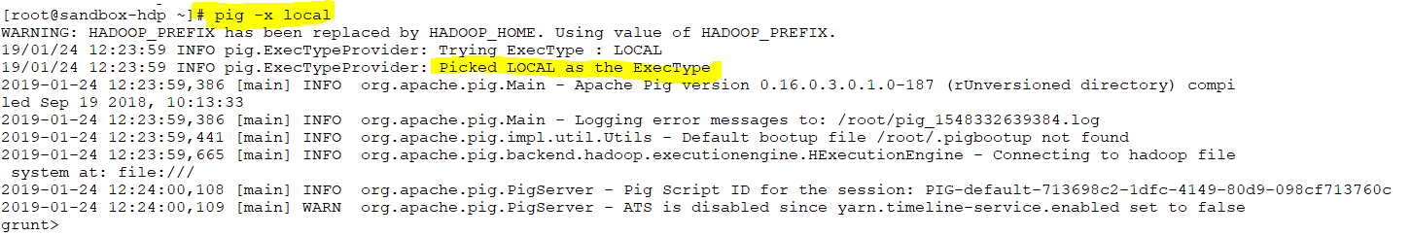
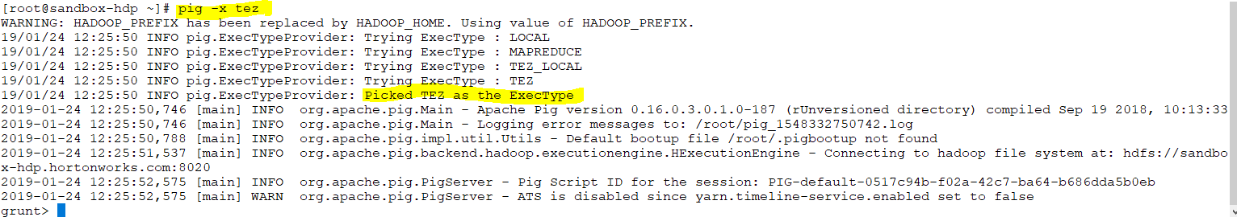

Slide 9
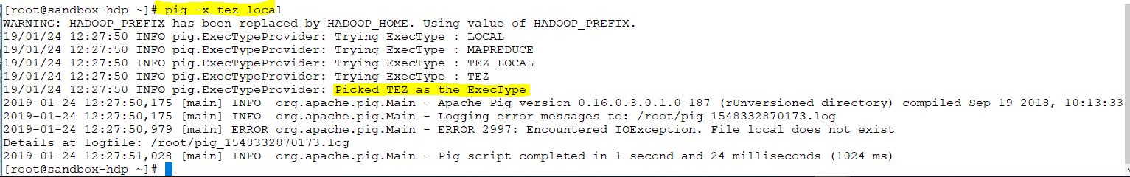
Notes:
-x is same as exectype
If you want to optimize the efficiency of your program then you might use .Means you need to make your program faster.

Slide 10
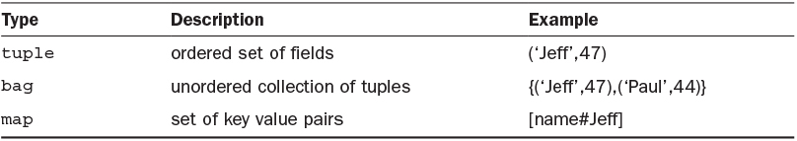
Data Structures
Datasets used by Pig are called relations or bags
Bags contain records called tuples
Tuples contain fields
Fields can contain data structures such as other bags or tuples, or atomic data called atoms
Notes:
Each PIG statement has one or more identifiers (for bags & fields). Identifier names should be case sensitive and cannot have the same name as any of the reserved keywords.
Also, identifier names must follow the below mentioned rules:
Begin with a letter
Can only include letters, numbers, and underscores
The reserved keywords are:
assert, and, any, all, arrange, as, asc, AVG, bag, BinStorage, by,bytearray, BIGINTEGER, BIGDECIMAL, cache, CASE, cat, cd, chararray,cogroup, CONCAT, copyFromLocal, copyToLocal, COUNT, cp, cross,datetime, %declare, %default, define, dense, desc, describe, DIFF,distinct, double, du, dump, e, E, eval, exec, explain, f, F, filter,flatten, float, foreach, full, generate, group, help, if, illustrate,import, inner, input, int, into, is, join, kill, l, L, left, limit,load, long, ls, map, matches, MAX, MIN, mkdir, mv, not, null, onschema,or, order, outer, output, parallel, pig, PigDump, PigStorage, pwd,quit, register, returns, right, rm, rmf, rollup, run, sample, set,ship, SIZE, split, stderr, stdin, stdout, store, stream, SUM, TextLoader,TOKENIZE, through, tuple, union, using, void

Slide 11
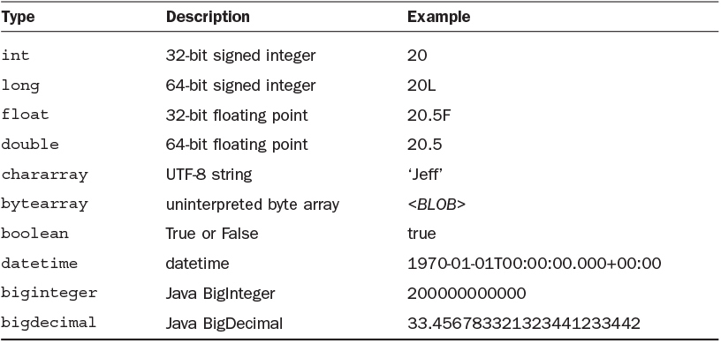
Simple Datatypes

Slide 12
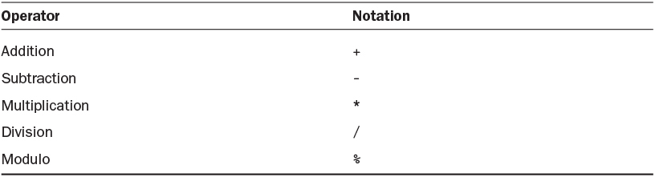
Mathematical Operators

Slide 13
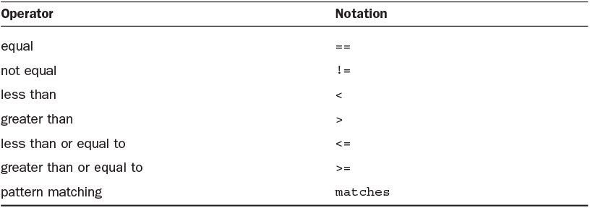
Relational Operators
In Hive WE HAVE ‘=‘ BUT IN Pig we have ‘==‘

Slide 14
Code Rules
Statements must be terminated by a semicolon
Statements always begin by assigning a dataset to a bag, either through the process of loading data or manipulating a previously defined bag
A PIG program is evaluated using either STORE or a DUMP statement, which is always the last statement of a program
Keywords (such as LOAD, STORE, FOREACH, etc.) are capitalized by convention
Most of the built-in functions in Pig (such as COUNT or SUM) are case sensitive
Inline or single comments are prepended using “--”
Multi line comments are specified using /* … */

Slide 15
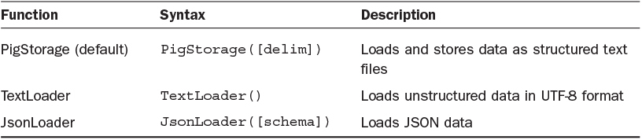
Load Functions
Notes:
The load function is supplied using the USING clause. If the USING clause is omitted, the data is assumed to be tab delimited text data
There are many other additional load functions in Pig including HBaseStorage, AvroStorage, AccumuloStorage, OrcStorage etc.
There are many permutations to loading data initially such as the following:
Loading data with no defined schema
Loading data with a schema (named fields) but no assigned data types
Loading data with a schema and assigned data types
Note:
When neither field names nor field types are specified, fields are accessed using their relative positions i.e. $0, $1 etc. while the field values are of type byte array
When field names are specified but their types are not specified, the types are byte array by default

Slide 16
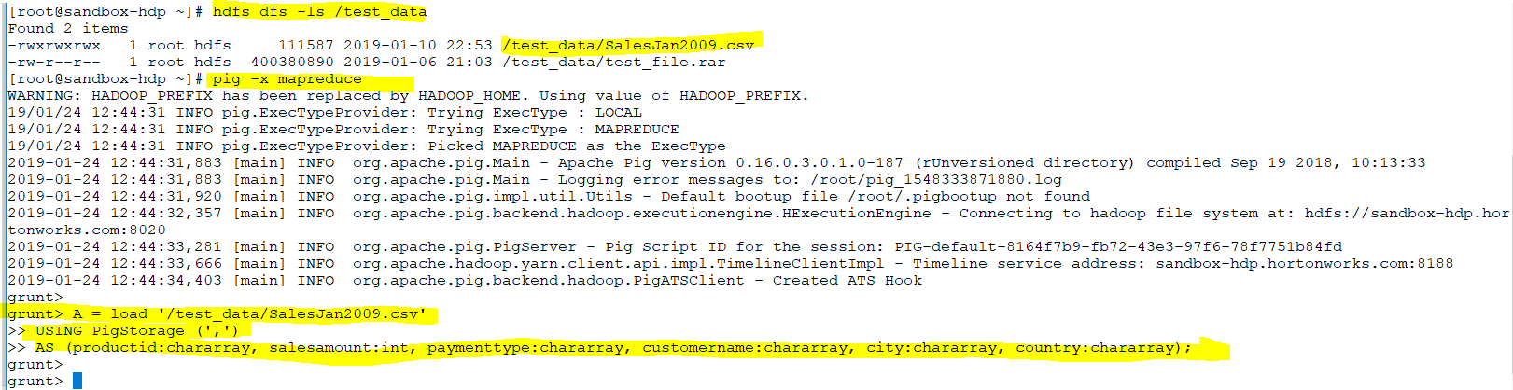
A PIG program is evaluated using either STORE or a DUMP statement, which is always the last statement of a program
Notes:
Load the csv file to pig by using PigStorage and parse it by ‘,’
Load function could be TextLoader or JsonLoader but ours is structure csv file
We also need to tell about schema )
As is optional .It attach a schema to each record using load function
If we do not use schema then Pig will attach the default schema which is Byte array .The problem with Byte array is you can not read it .We need to get value .Its unreadable for human. Because it change to bytes.
If we do not specify the delimiter then it will be controller but we have mentioned ‘,’ .
Controller is a separator
We ran it but nothing happen???!!!!
Something is happened .Its not going to execute it .It will evaluating the program .
A is a Bag or relation where this entire file content returns.
A = load ‘test_data/SalesJan2009.csv’
USING PigStorage(‘,’)
AS (productid:chararray, salesamount:int, paymenttype:chararray, customername:chararray, city:chararray, region:chararray, country:chararray);

Slide 17
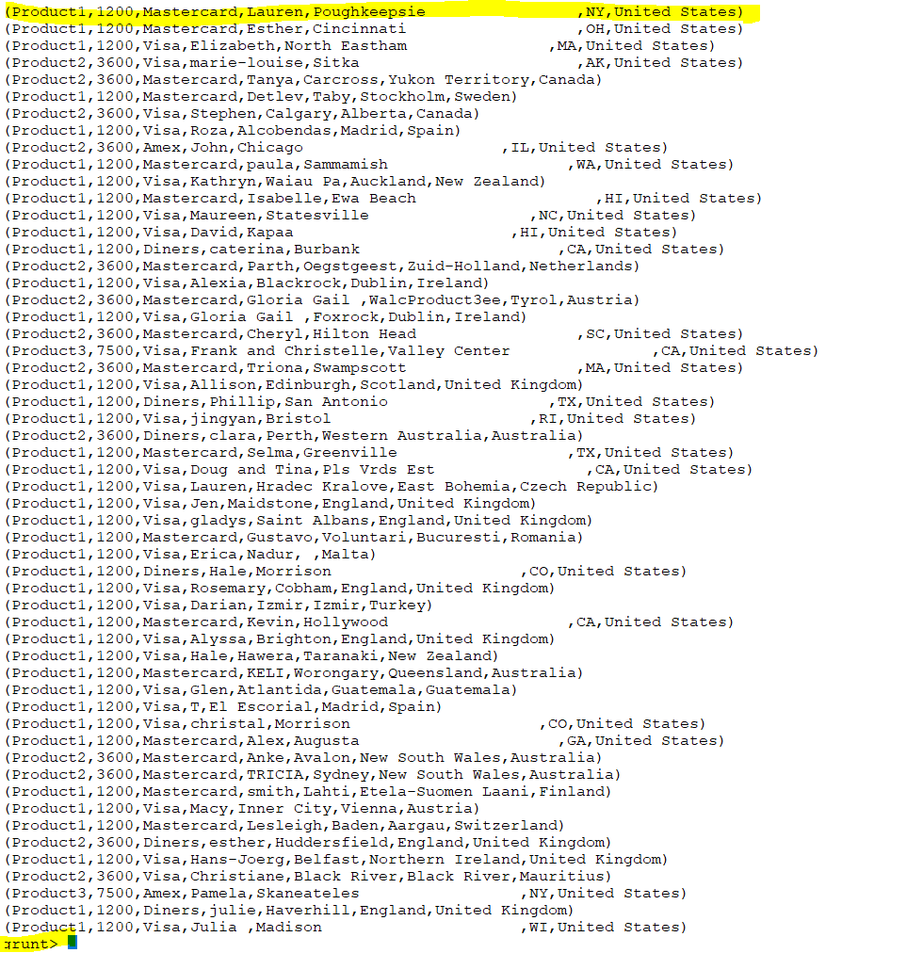

Slide 18
Lazy Evaluation in PIG
PIG Latin is a dataflow language. Pig Latin statements are entered interactively using the Grunt shell. Each statement is parsed and interpreted as it is entered. However, execution begins when output is requested, either to the console or to an output directory. This process is called lazy evaluation.

Slide 19
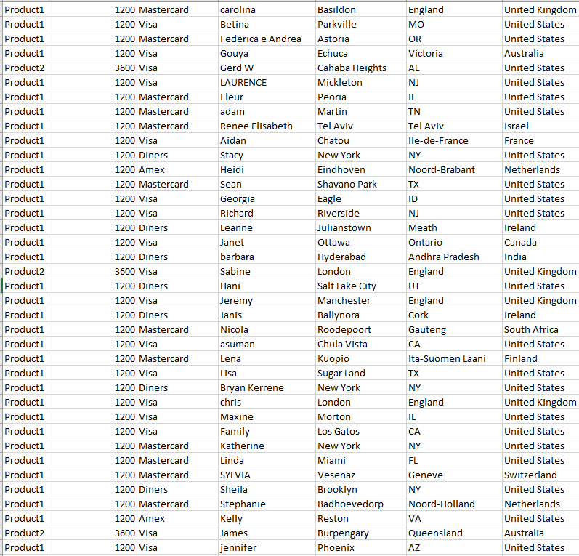
Notes:
The entire data set is Bag
Each row is a tuple
Each entity is a field

Slide 20
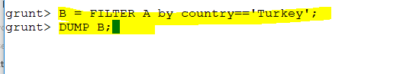
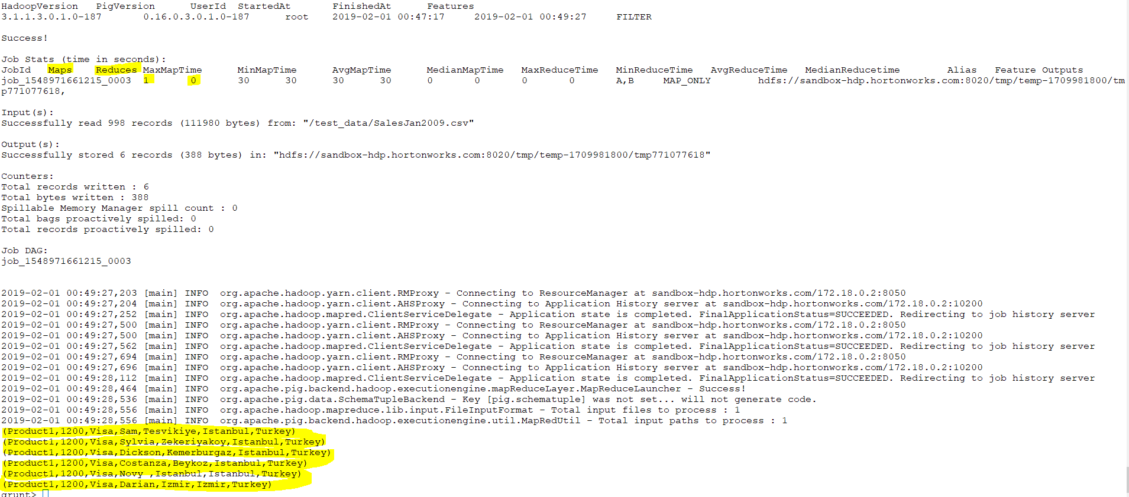

Slide 21
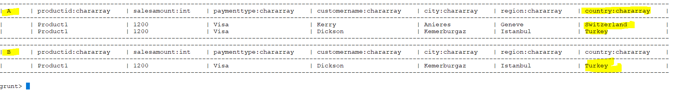
Notes:
B IS DERIVED FROM A .
A PARTS OINLY shows you a sample.

Slide 22
Notes:
Describe PRINTS THE SCHEMA OF B
HOWEVER If you do illustrate it will not show you the schema it

Slide 23
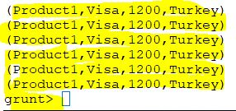

Slide 24
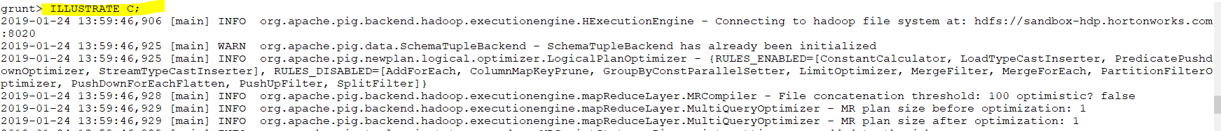
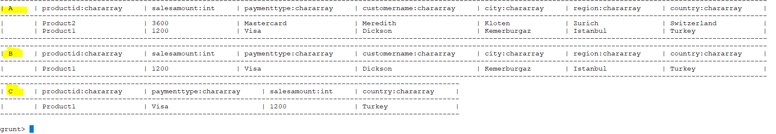
Notes:
Foreach means for each tuple in B generate
A = load '/test_data/SalesJan2009.csv’
USING PigStorage (',’)
AS (productid:chararray, salesamount:int, paymenttype:chararray, customername:chararray, city:chararray,region:chararray, country:chararray);
B = FILTER A by country =='Turkey’;
C = FOREACH B GENERATE productid, paymenttype, salesamount, country;

Slide 25
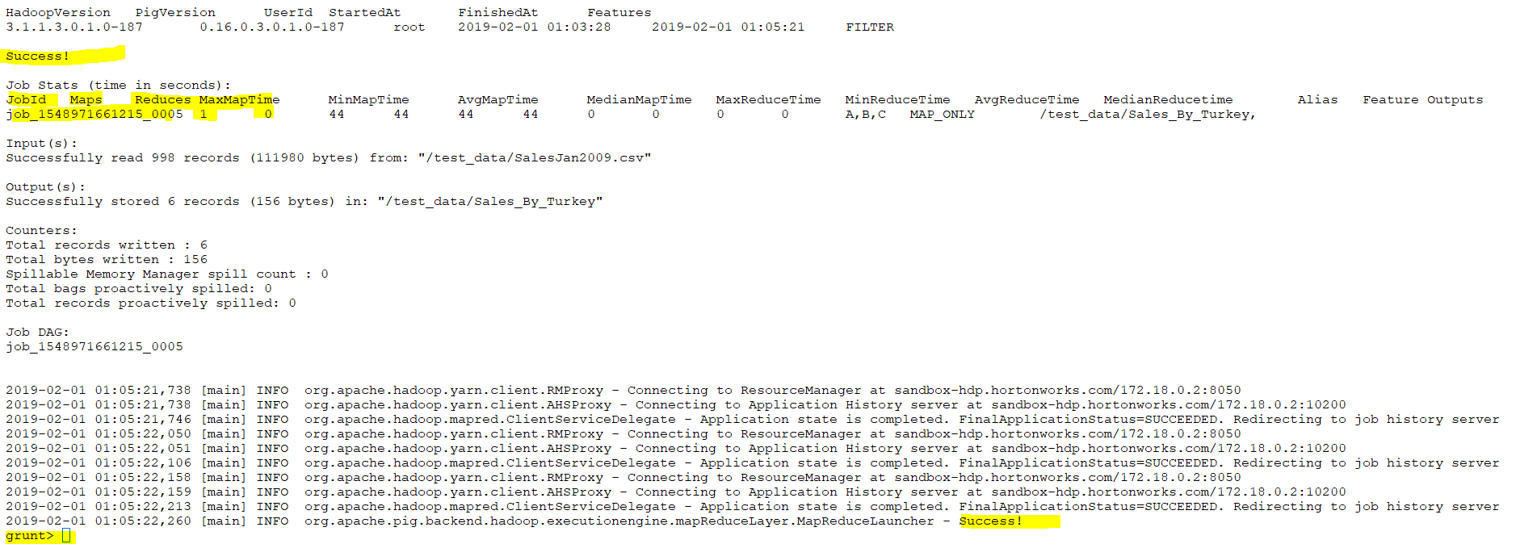
Notes:
Part-m means mapper

Slide 26
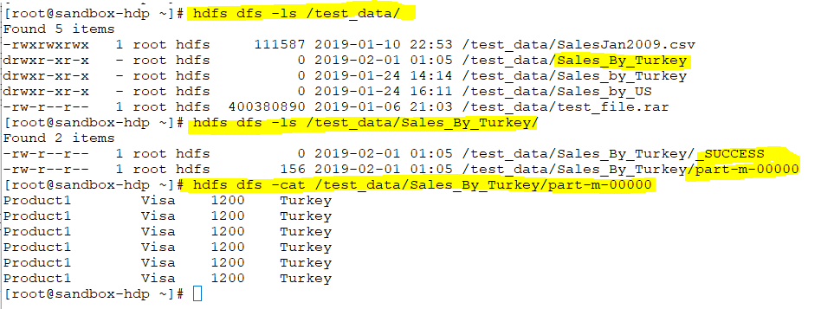

Slide 27
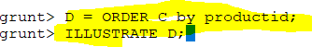
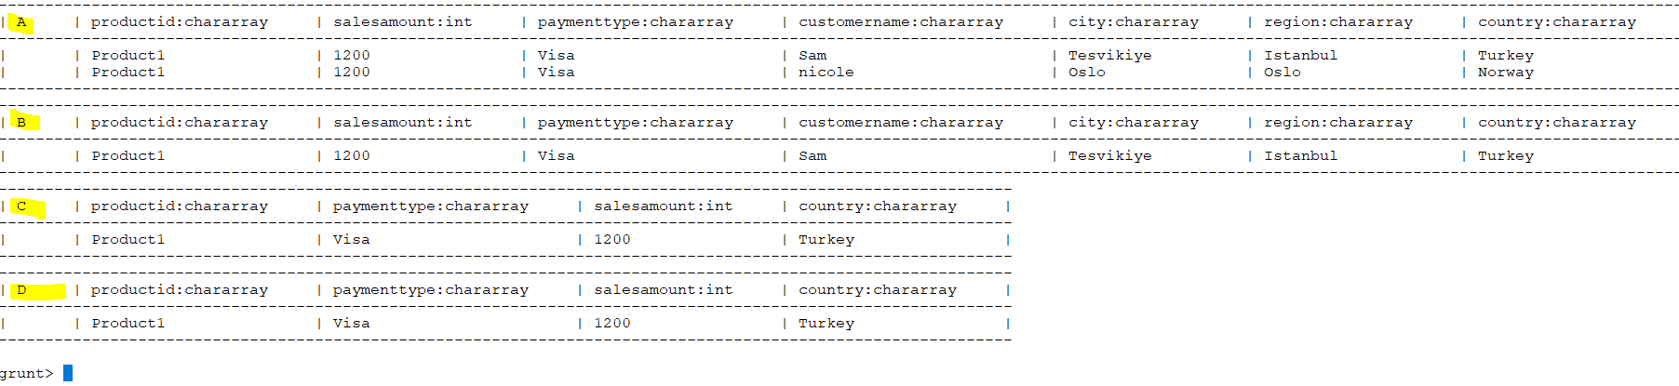

Slide 28
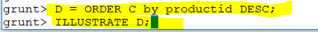
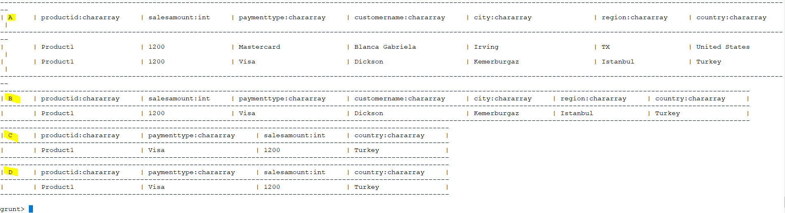

Slide 29
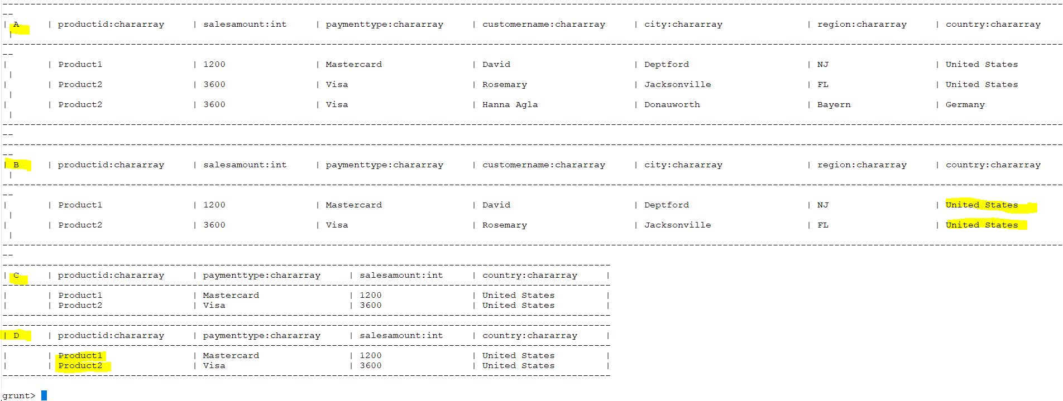
Notes:
A = load '/test_data/SalesJan2009.csv'
USING PigStorage (',')
AS (productid:chararray, salesamount:int, paymenttype:chararray, customername:chararray, city:chararray, region:chararray, country:chararray);
B = FILTER A by country =='United States';
C = FOREACH B GENERATE productid, salesamount, paymenttype, country;
D = ORDER C by productid;
ILLUSTRATE D;

Slide 30
Notes:
A = load '/test_data/SalesJan2009.csv'
USING PigStorage (',')
AS (productid:chararray, salesamount:int, paymenttype:chararray, customername:chararray, city:chararray, region:chararray, country:chararray);
B = FILTER A by country =='United States';
C = FOREACH B GENERATE productid, salesamount, paymenttype, country;
D = ORDER C by productid;
DUMP D;

Slide 31
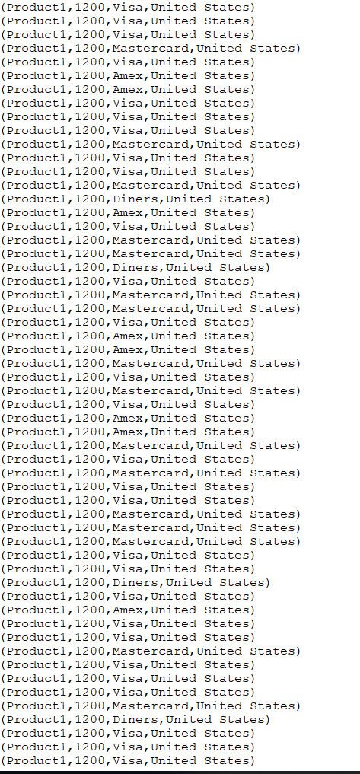
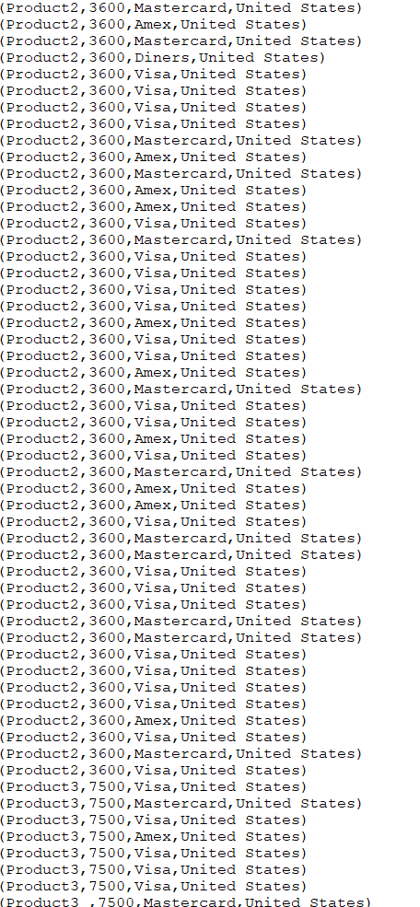
Notes:
1:34

Slide 32
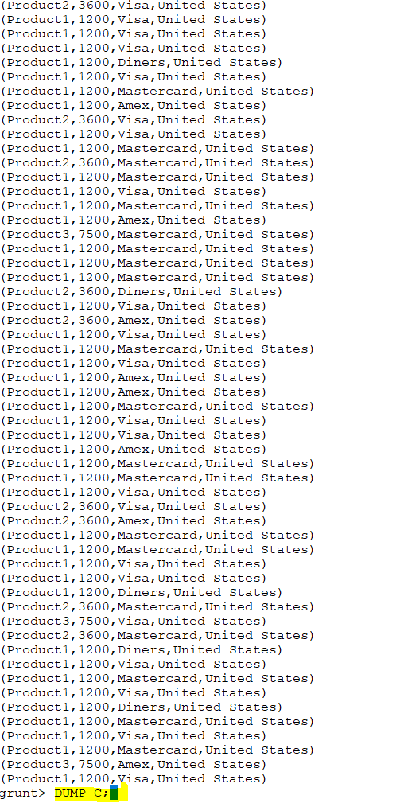

Slide 33
Notes:
C = FOREACH B GENERATE SUBSTRING(productid, 7, 8) as productid, salesamount, paymenttype, country;
D = ORDER C by productid DESC;

Slide 34
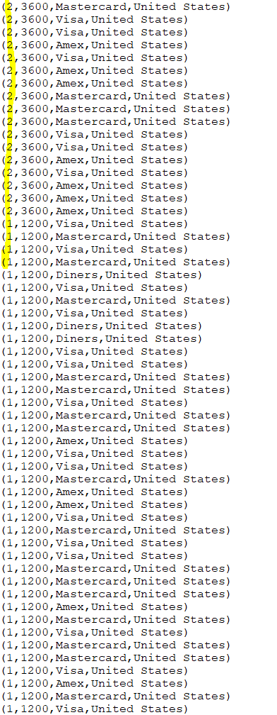
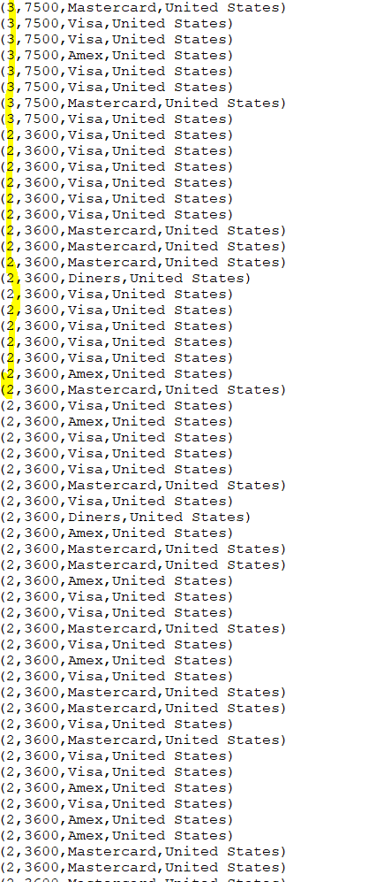

Slide 35
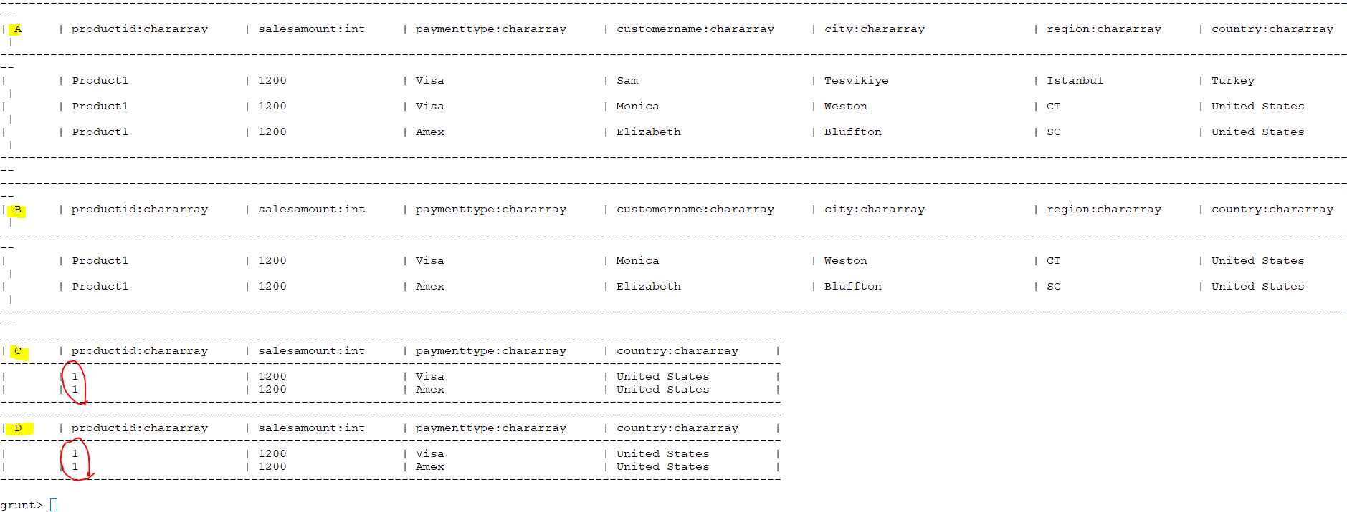

Slide 36
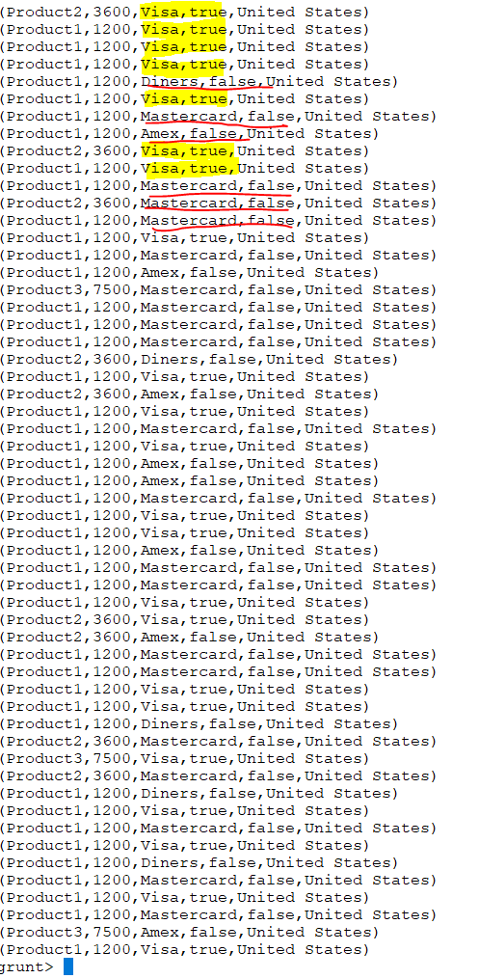
Notes:
C = FOREACH B GENERATE productid, salesamount, paymenttype, STARTSWITH(paymenttype, 'Visa'), country;
DUMP C;

Slide 37
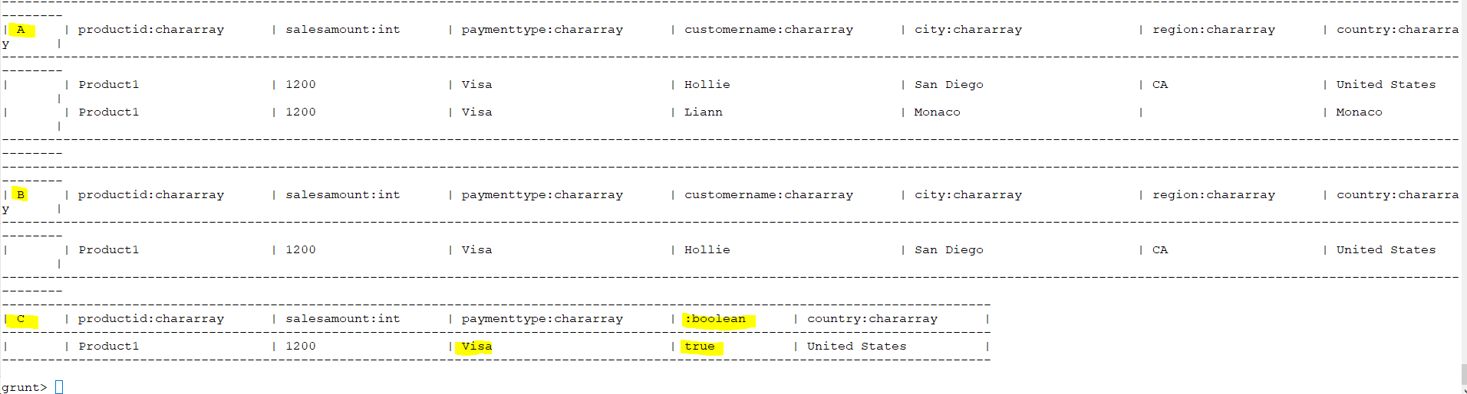

Slide 38
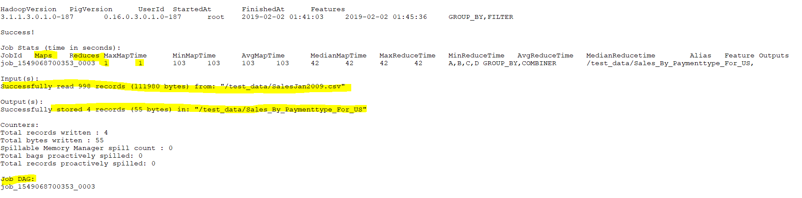
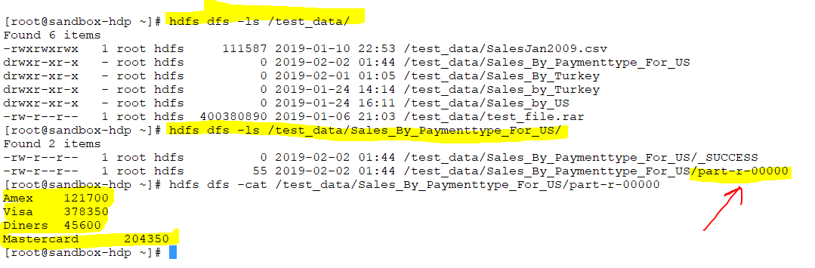
Notes:
A = load '/test_data/SalesJan2009.csv'
USING PigStorage (',')
AS (productid:chararray, salesamount:int, paymenttype:chararray, customername:chararray, city:chararray, region:chararray, country:chararray);
B = FILTER A by country =='United States';
C = GROUP B by paymenttype;
D = FOREACH C GENERATE group as paymenttype, SUM(B.salesamount) as total_sales;
STORE D INTO '/test_data/Sales_By_Paymenttype_For_US';

Slide 39
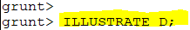
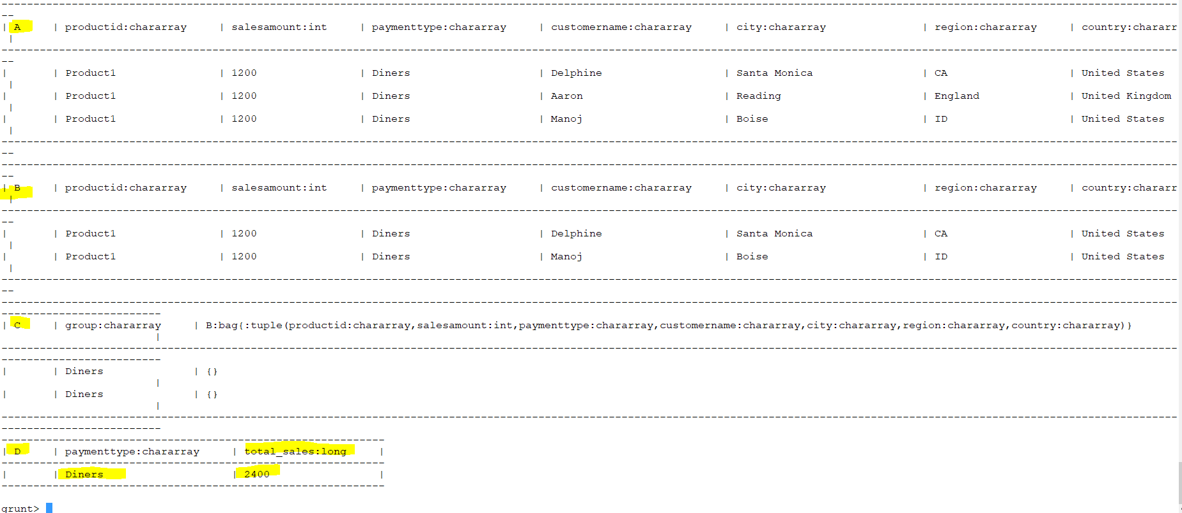

Slide 40
DAG or directed acyclic graph
Notes:
Every pig job CREATE DAG DIRD ASYCLIC GRAPH
LAZY EVALUATED. A equal to something means it just evaluate A and creates a node and put it in the dag.For B it creates another node but put in the same DAG .Same for C (Different DAG) .When it come to D it’s a action .same thing (Different DAG)
What pig does ? It executes the first nodes then second nodes then third then forth which is action
There is a problem ?
D comes from c and c comes from B and B comes from A
HOW A PIG PROGRAM EXECUTE? IT LAZY EVALUATED. A equal to something means it just evaluate A and creates a node and put it in the dag
For B it creates another node but put in the same DAG
Same for C
When it come to D it’s a action .same thing
What pig does ? It executes the first nodes then second nodes then third then forth which is action
There is a problem ?
Every time you run a command like Illustrate D ; First it will evaluate A and put it in a node
When is come to B it will put in the node in the same
directed acyclic graph (DAG)

Slide 41
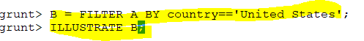
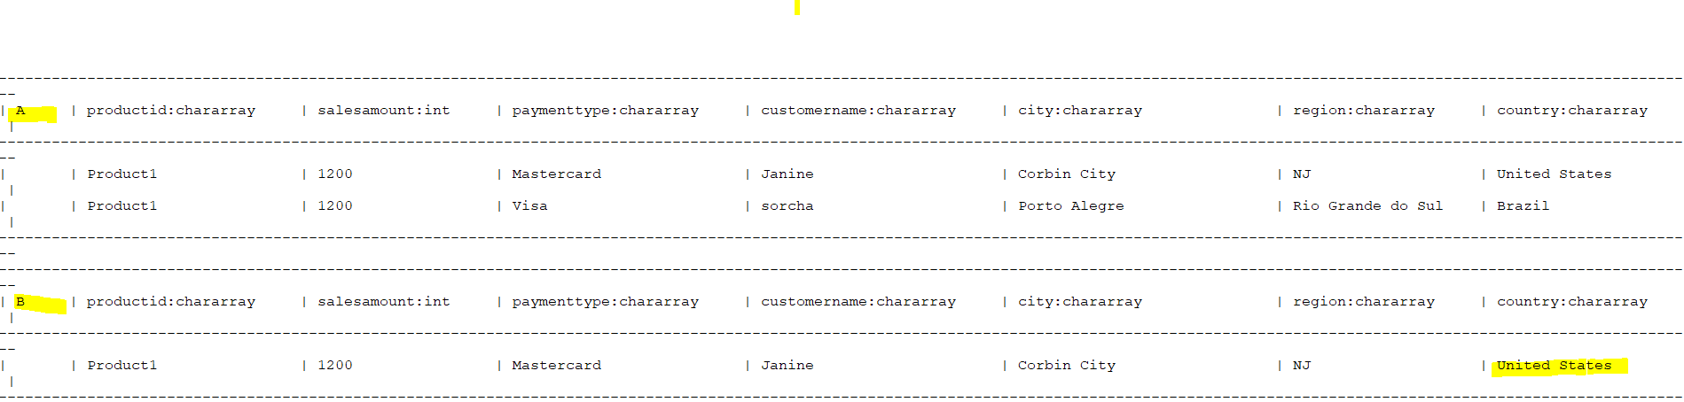
Notes:
B = FILTER A BY country=='United States';
ILLUSTRATE B;

Slide 42
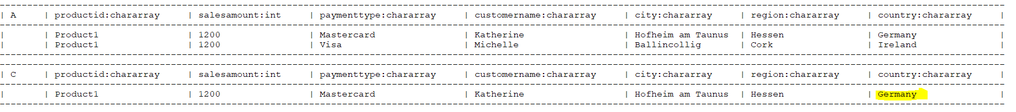
Notes:
C = FILTER A BY country=='Germany';

Slide 43
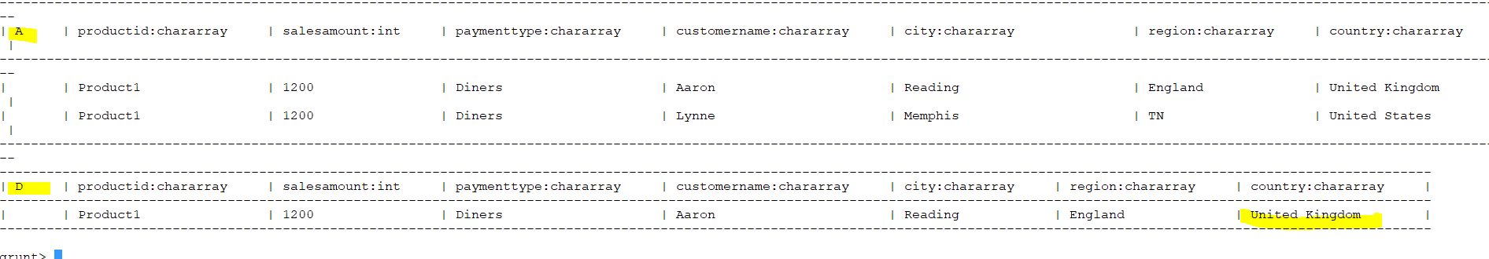
Notes:
D = FILTER A BY country=='United Kingdom';

Slide 45
A
A
A
B
C
D
C = FILTER A BY country=='Germany';
B = FILTER A BY country=='United States';
D = FILTER A BY country=='United Kingdom';
One DAG
One DAG
One DAG
Notes:
I have created A and then B
I have created A and then c
I have created A and then D
IT CREATES THREE DAG .More number of DAG created more time so we need to reduce the time.Its not efficient so we put split
We are branching from A
Three times the program will run

Slide 46
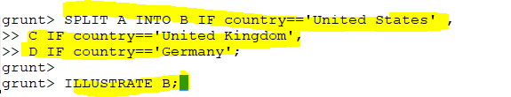
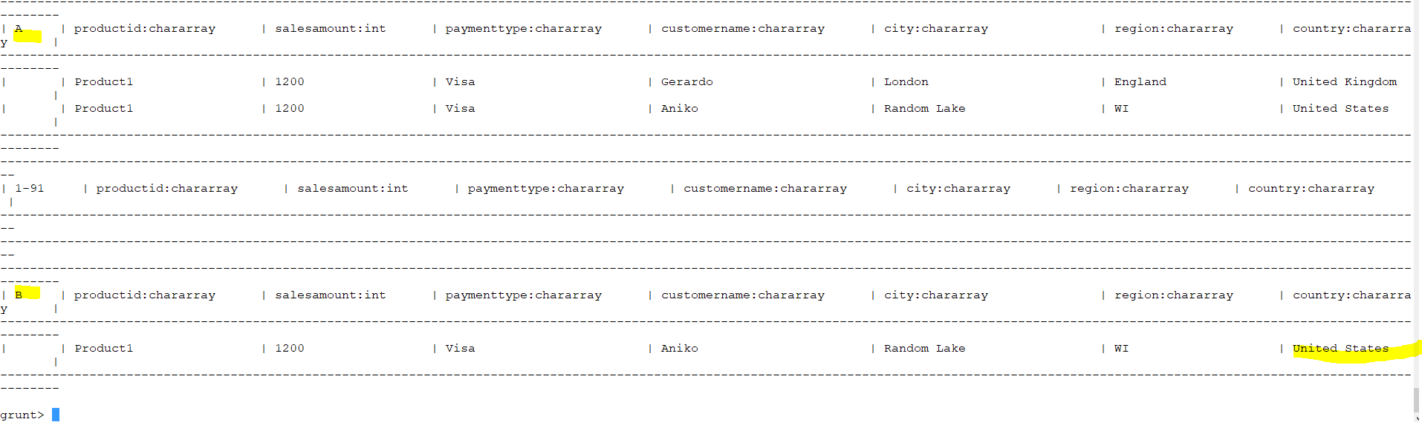
SPLIT
Notes:
SPLIT A INTO B IF country=='United States' ,
C IF country=='United Kingdom',
D IF country=='Germany';

Slide 47
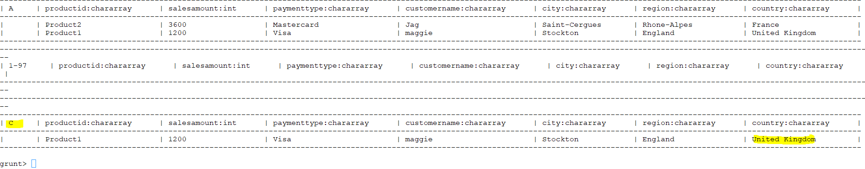
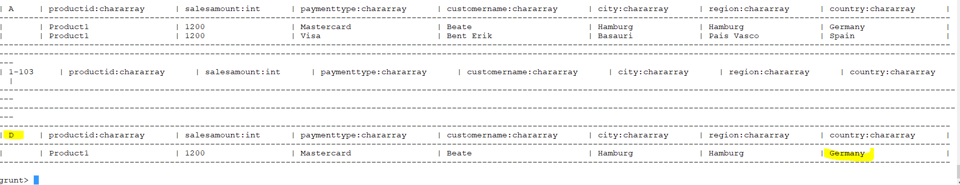
A
B
C
D
Notes:
Instead of filter we use split. more efficient
The first node in the dag is node A then there are three nodes there Node B,C and D
For example I did filter on A to get B
Then I did filter on A to get c
Then I did filter on A to get D
So I have three separate program .The program runs three times. Three separate flow
A –B then THE REST OF B
A- C then THE REST OF C
A- D then THE REST OF D
IN SPLIT as you can see in the diagram it branches to three

Slide 48
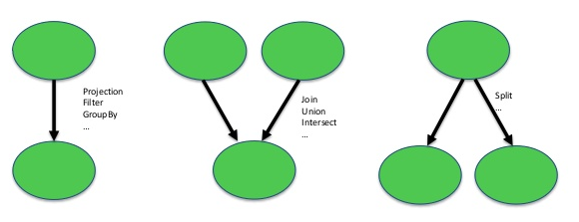
Notes:
Any complicated DAG can be composed of the following 3 basic paradigm of DAG
Sequential
Merge
Divide

Slide 49
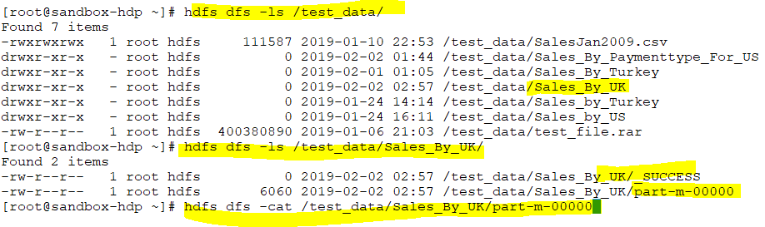
Notes:
STORE C INTO '/test_data/Sales_By_UK' using PigStorage('|');

Slide 50


Slide 51

Pig Script
Notes:
Pig Script
A =load '/test_data/SalesJan2009.csv'
USING PigStorage (',')
AS (productid:chararray, salesamount:int, paymenttype:chararray, customername:chararray,
city:chararray, region:chararray, country:chararray);
B = FILTER A by country =='United States';
STORE B INTO '/test_data/Sales_By_US' USING PigStorage('|');

Slide 52


Slide 53


Slide 54

Notes:
Sometimes within pig script do some shell scripting like hdfs .

Slide 55

Notes:
Run has capability of accessing things outside the pig shell but exec is only available inside the pig shell

Slide 56



Notes:
B = LOAD ‘test_data/tweets.txt’
USING TextLoader()

Slide 57

B = LOAD ‘test_data/tweets.txt’
USING TextLoader() ;

Slide 58
Sqoop

Slide 59

Apache Sqoop
What is it ?
How does it work ?
Interfaces
Examples
Architecture

Slide 60

What is it ?
Sqoop is a tool designed to transfer data between Hadoop and relational databases or mainframes. You can use Sqoop to import data from a relational database management system (RDBMS) such as MySQL or Oracle or a mainframe into the Hadoop Distributed File System (HDFS), transform the data in Hadoop MapReduce, and then export the data back into an RDBMS.
Notes:
Why do we need to use Sqoop ? We use Transactional data store (day to day like banks) and Analytics purpose which is done by Hadoop so for transactional data store we can not use Hadoop .To analysis transactional data for 10 years (like SQL ) we need to transform the data by using Sqoop then use Hive.
A command line interface (plus web in scoop2)
For data import/export to Hadoop
Uses Map jobs from Map Reduce
Supports incremental loads
Written in Java
Licensed by Apache
Uses plugins for new types of data source

Slide 61
Scoop –How does it work
Data sliced into partitions
Mappers transfer data
Data types determined via meta data
Many data transfer formats supported (i,.e CSV ,Avro)
Can import into
Hive (use –hive-import flag)
Hbase (use –hbase*flags)

Slide 62
Scoop -Interfaces
Get data from
Relational databases
Data warehouses
No SQL databases
Load to Hive and Hbase
Integrates with Oozie for scheduling

Slide 63

Sqoop -Example
An example scoop command to
-load data from mySql into Hive

Slide 64
Sqoop -Architecture
Sqoop has moved from Scoop 1 to Scoop2
Changed from client to server install
Now has web and command line access
Server now accesses Hive & Hbase
Oozie uses REST API
Notes:
REST API ;a set of .... Web service APIs

Slide 65

Sqoop –Architecture –Scoop 1

Slide 66

Sqoop –Architecture –Scoop 2

Slide 67


Notes:
How to find your db

Slide 68

Notes:
User name: root
Password : hortonworks1

Slide 69



Slide 70

Notes:
We can import to Hive or HDFS location .
Sqoop can not do ETL .it does ingestion. We can ingest the data and pig can take it from there or put it in Hive HDFS LOCATION.
In certain cases we may not NEED TO TRANSFORM ANYTHING ON DATA so we just need to import it to Hive table.

Slide 71


Slide 72


Slide 73


Slide 74

Notes:
sqoop-import --connect jdbc:mysql://sandbox-hdp.hortonworks.com/hive --username root --P --table TBLS --target-dir /user/pedram/sqoop --fields-terminated-by '|' --num-mappers 7

Slide 75


Slide 76


Slide 77


Slide 78


Slide 79

Notes:
Sqoop use map reduce operation .By default is four .EACH MAPPER LOAD SOME PART OF THE DATA.

Slide 80


Notes:
Custom columns
sqoop-import --connect jdbc:mysql://sandbox-hdp.hortonworks.com/hive --username root --P --table ROLES --target-dir /user/pedram/sqoop/hive_roles --columns "ROLE_ID, OWNER_NAME, ROLE_NAME" --fields-terminated-by '|'

Slide 81


Notes:
Sqoop only takes the data not headers

Slide 82

Notes:
What about if we want to filter by rows like where clause
Sqoop only import the tables not entire DB.

Slide 83


Slide 84

Notes:
sqoop-import --connect jdbc:mysql://sandbox-hdp.hortonworks.com/hive --username root --P --table TBLS --target-dir /user/pedram/sqoop/tbls --fields-terminated-by '|' --num-mappers 8

Slide 85


Slide 86



Slide 87

Notes:
When we use connect it actually uses connection-manager and driver internally .
Using the connect we specify jdbc it use connection-manager and driver to connect to db SO SQOOP CAN RUN
They are already installed.
In not all cluster is installed so you have to copy the jar file in lip folder (sqooplip) then specify the class name

Slide 88


Slide 89

Notes:
We can provide the password in the file and use –password-file
But that file should have only the password

Slide 90

sqoop-import --connect jdbc:mysql://sandbox-hdp.hortonworks.com/hive --username root --P --table TBLS --target-dir /user/pedram/sqoop/tbls --fields-terminated-by '|' --num-mappers 8
Notes:
All the parameters can be put in the file like --username root --P --table TBLS --target-dir /user/pedram/sqoop/tbls --fields-terminated-by '|' --num-mappers 8

Slide 91

Notes:
Isolation Is such that if a process is using a transaction to update the data ,any other process going to read the data (same data) it will gets a snap shot from the data which was presents just before the update .
It will give the previous value not the current one unless the update is done .
Isolation is about transaction .It facilitates the transaction .there is a process which writing to db .if there is another transaction going on it will not write to db .
It lock the db.
Like when you are synchronizing the db

Slide 92

Notes:
It used for validation

Slide 93


Slide 94


Notes:
sqoop-import --connect jdbc:mysql://sandbox-hdp.hortonworks.com/hive --username root --P --table TBLS --target-dir /user/pedram/sqoop/tbls --fields-terminated-by '|' --num-mappers 8
As you can see the sqoop folder is already there so when I run the command I receive an error .I need to go and delete it .Instead I can use “--delete-target-dir” and it will delete the directory for us
sqoop-import --connect jdbc:mysql://sandbox-hdp.hortonworks.com/hive --username root --P --table TBLS --target-dir /user/pedram/sqoop/tbls --fields-terminated-by '|' --num-mappers 8 --delete-target-dir

Slide 95


Slide 96


Slide 97


Free-form Query Imports
Notes:
Free-form Query Imports
Sqoop can also import the result set of an arbitrary SQL query. Instead of using the --table, --columns and --where arguments, you can specify a SQL statement with the --query argument.
When importing a free-form query, you must specify a destination directory with --target-dir.
If you want to import the results of a query in parallel, then each map task will need to execute a copy of the query, with results partitioned by bounding conditions inferred by Sqoop. Your query must include the token $CONDITIONS which each Sqoop process will replace with a unique condition expression. You must also select a splitting column with --split-by.
$ IS EVALUATION
sqoop-import --connect jdbc:mysql://sandbox-hdp.hortonworks.com/hive --username root --P --query 'select * from TBLS where $CONDITIONS limit 75' --target-dir /sqooplab/tbls --fields-terminated-by '|' --num-mappers 8 --delete-target-dir --split-by TBl_ID

Slide 98


Slide 99

Notes:
$ conditions will be replaced by select * from TBLS where (TBL_ID >= 1 AND TBL_ID <= 10) for the first mapper
.
.
.
.
$ conditions will be replaced by select * from TBLS where (TBL_ID >=70 AND TBL_ID <= 75) for the last mapper
We have to choose a split table such a way that mapper use equal data
We have identified that mapper number as 8 so it will create 8 buckets and look in to the Table_id
$conditions MEANS SPLIT CONDITION

Slide 100

My data type might be different from the type in Hive
If we are importing to HDFS we use java otherwise we import to Hive then it will be Hive
Notes:
What about type mapping ? My data type might be different from the type in Hive
If we are importing to HDFS we use java otherwise we import to Hive then it will be Hive
Sqoop is preconfigured to map most SQL types to appropriate Java or Hive representatives. However the default mapping might not be suitable for everyone and might be overridden by --map-column-java (for changing mapping to Java (HDFS)) or --map-column-hive (for changing Hive mapping).

Slide 101

Notes:
Sqoop supports two types of incremental imports: append and last modified.
You can use the --incremental argument to specify the type of incremental import to perform.
You should specify append mode when importing a table where new rows are continually being added with increasing row id values. You specify the column containing the row’s id with --check-column. Sqoop imports rows where the check column has a value greater than the one specified with --last-value.
An alternate table update strategy supported by Sqoop is called last modified mode. You should use this when rows of the source table may be updated, and each such update will set the value of a last-modified column to the current timestamp. Rows where the check column holds a timestamp more recent than the timestamp specified with --last-value are imported.
At the end of an incremental import, the value which should be specified as --last-value for a subsequent import is printed to the screen. When running a subsequent import, you should specify --last-value in this way to ensure you import only the new or updated data. This is handled automatically by creating an incremental import as a saved job, which is the preferred mechanism for performing a recurring incremental import. See the section on saved jobs later in this document for more information.

Slide 102


Slide 103


Slide 104

Notes:
Split by id : primary key

Slide 105


Slide 106


Slide 107


I removed delete as I am appending .I do not want to remove the previous directory
Notes:
sqoop-import --connect jdbc:mysql://sandbox-hdp.hortonworks.com/db_test --username root --P --table incr_tbl --target-dir /user/pedram/sqoop/empl --fields-terminated-by '|' --table empl --split-by id --incremental append --check-column id --last-value 8;

Slide 108

Notes:
As you can see it appended here .It added four more mapper

Slide 109



Slide 110

Notes:
After I updated b to b1 I run the query again with append

Slide 111

You see that it has not taken the b1 so we need to use last modified
Notes:
You see that it has not taken the b1 so we need to use last modified

Slide 112

Import data to Hive table
Notes:
Import data to Hive table
Sofar we saw that we can import to Hive table

Slide 113



Slide 114


Slide 115

Notes:
sqoop-import --connect jdbc:mysql://sandbox-hdp.hortonworks.com/hive --username root --P --table TXNS --hive-import --create-hive-table --hive-table employees --hive-database hive --split-by id -m 1;
IN MYSQL THERE IS A DB CALLED HIVE AND UNDER HIVE DB I have TXNS table which I use to import to Hive and name it as employee

Slide 116


Slide 117


